Slide 1
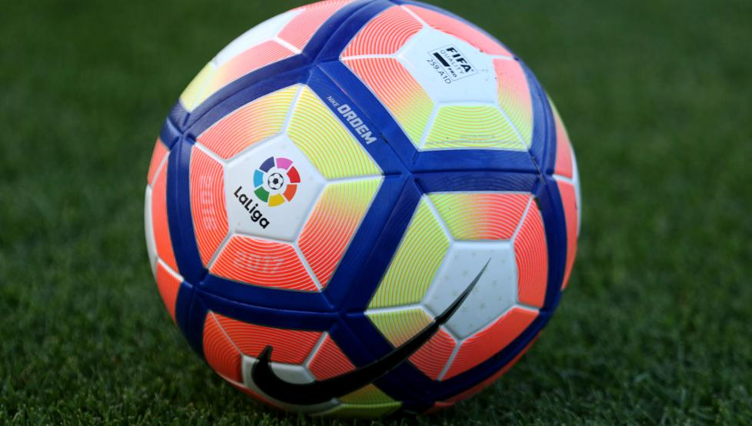
FUTBOL
Bedoya Rodríguez Jorfan Andrés
1001

Slide 2
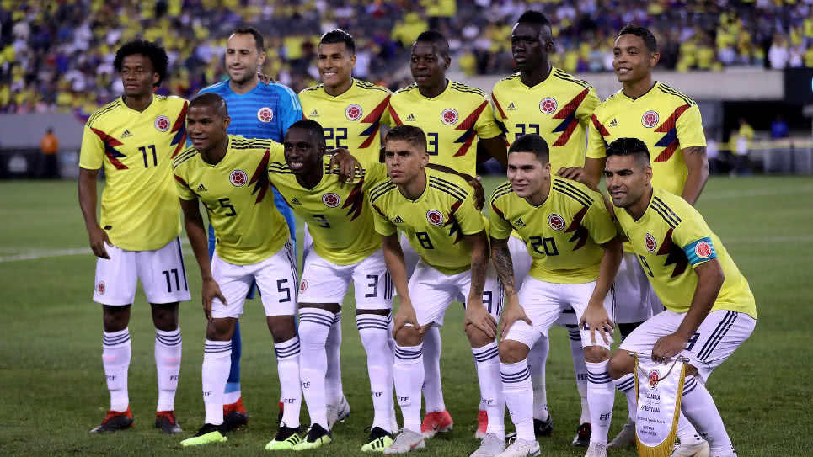
Football history
Soccer is a team player vetean two sets of eleven played each and some refereas that ensure that the rules are correctly followed. it is widely consideré the most popular sport in the world, as practiced by 270 million people.

Slide 3
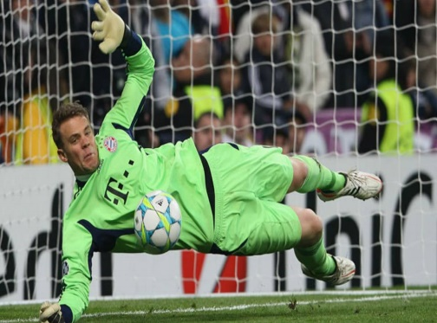
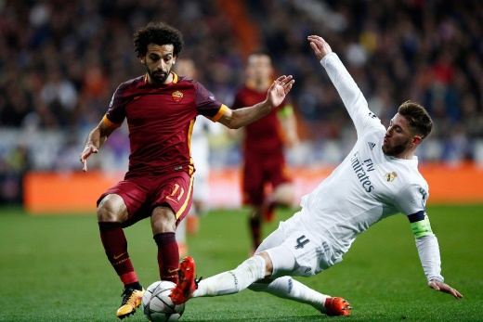
tactical position of the players
Goalkeeper: The goalkeeper, also known as goalkeeper, goalkeeper or goalkeeper, is the player whose main objective is to prevent the ball from entering its goal during the game, an act known as a goal.
Defense: The defender, also known as the defender, is the player located one line in front of the goalkeeper and one behind the midfielders, whose main objective is to stop the attacks of the opposing team.

Slide 4
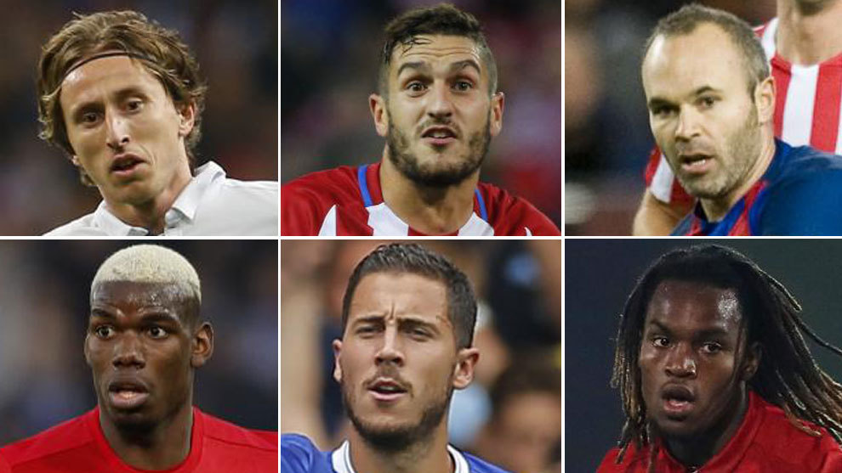
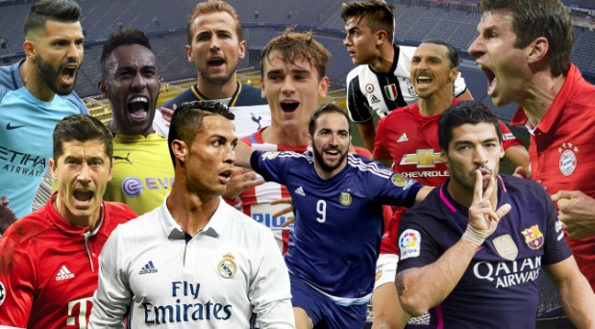
Positions
Midfielder: The midfielder, midfielder or midfielder is the person who plays in the midfield on a football field. Between its functions they are those of recovering balls, propitiate the creation of plays and to exploit the offensive game.
Strikers: A striker or attacker is a player of a football team who stands out in the attack position, the closest to the goal of the opposing team, and is therefore the main responsible for scoring goals.

