Slide 1
HEALTHY LIFESTYLES
Yilber Andres Nomesque Avila
Jorfan Andres Bedoya Rodriguez
Santiago Pantano
1001 J.M
INGLES

Slide 2
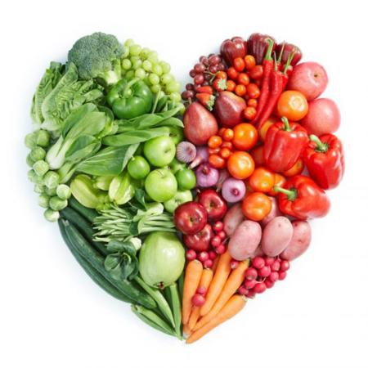
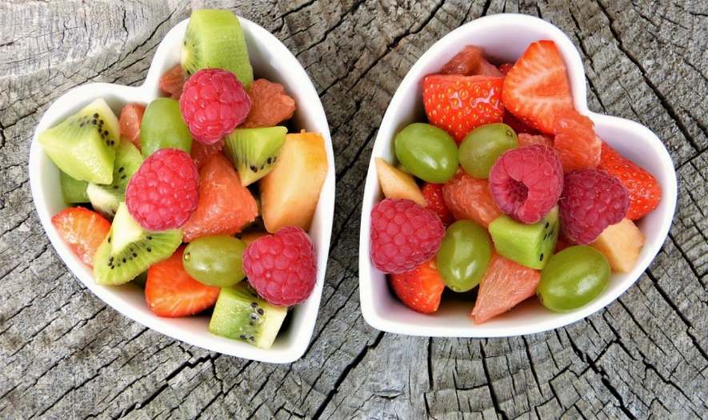
eat healthy
→ As a general rule, you should choose foods that are low in saturated fat and cholesterol. You should also limit your intake of sugar and salt. You should eat more foods with fiber, such as fruits, vegetables and cereals.
→ Make variations in your usual diet and try to eat everything. Avoid monotony.
→ Make five meals a day.
→ Chop between meals: try to avoid high-calorie products such as sweets or chocolates and take a piece of fruit.
→ There are foods that, due to their composition, we must limit their consumption. It is not necessary that you eliminate them from your diet, it only controls the frequency with which you take them and the quantity of them.
→ Fruits and vegetables: 5 a day. Its consumption decreases the risk of coming to many diseases
→ Water is an essential nutrient. You must drink at least 1.5 liters of fluid per day. Do not wait until you are thirsty to drink.
→ Whenever you can, avoid prepared meals and fast food. Choose fresh foods.
→ Eating quickly can cause digestive problems. Enjoy your food: take your time, sit back and relax.
→ Check the labels of the food you buy. You can enjoy our list of healthy foods

Slide 3
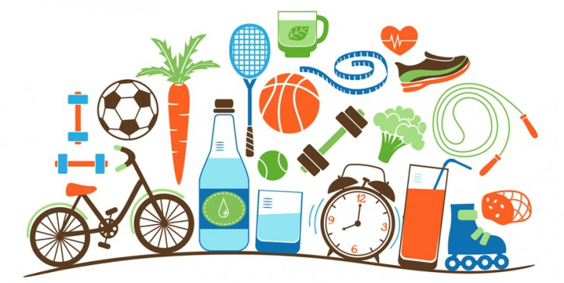

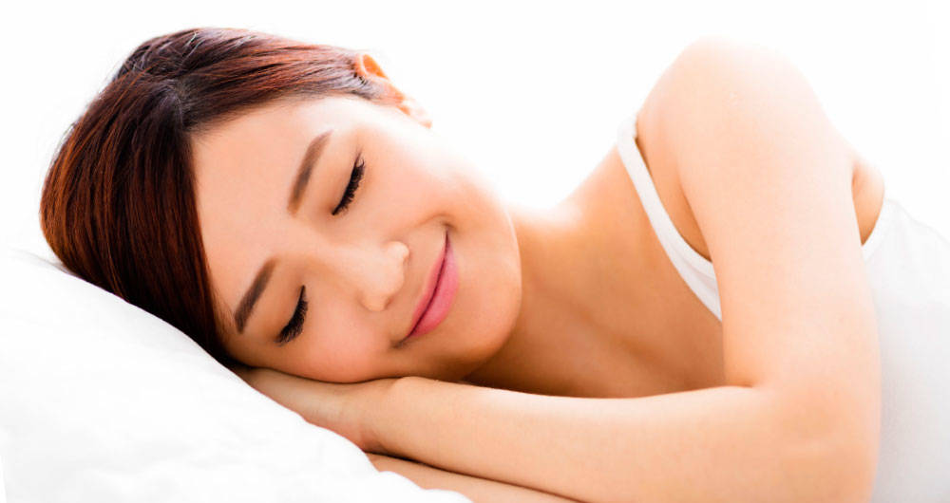
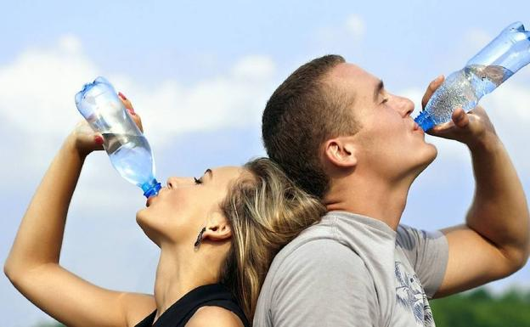
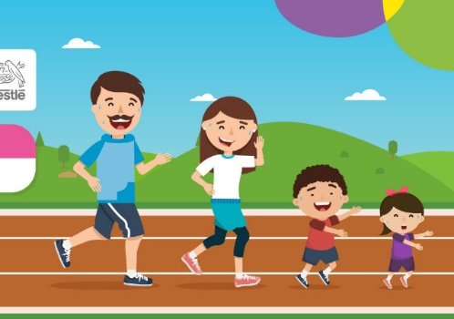
HEALTHY HABITS
1 - Feeding properly: Eating a balanced diet is key. Food of all kinds can be included, but excesses should be avoided. We must provide nutrients to the body to function properly.
2- Do physical activity: Performing exercise consistently produces multiple benefits, such as reducing the risk of cardiovascular diseases, burning calories, and strengthening muscles and bones. In addition, it reduces the "bad" cholesterol and increases the "good" cholesterol.
3- Be hydrated: It is essential to drink at least three liters of water per day. In this way, toxins are eliminated, metabolism and digestion are favored, and the appearance of the skin and hair is improved
4- Sleep well: Sleeping is one of the most essential functions to feel good. Clinical doctor María Fernanda Testa (M.N 81.982) recommends "sleeping between six and eight hours a day to recover lost energy."
5- Little alcohol, cigarette nothing: Ingesting excess alcohol and smoking are two harmful habits for the organism. Over time they can have harmful effects. Therefore, it is advisable to leave them aside.

Slide 4
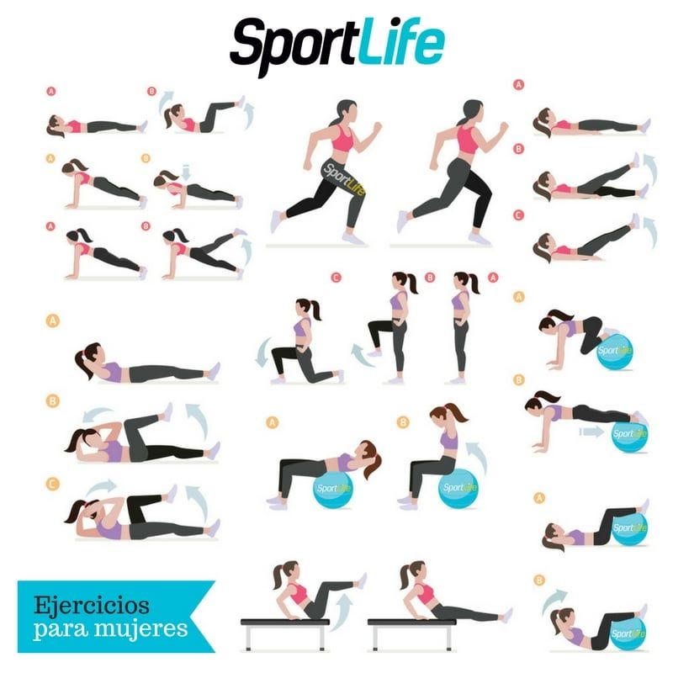
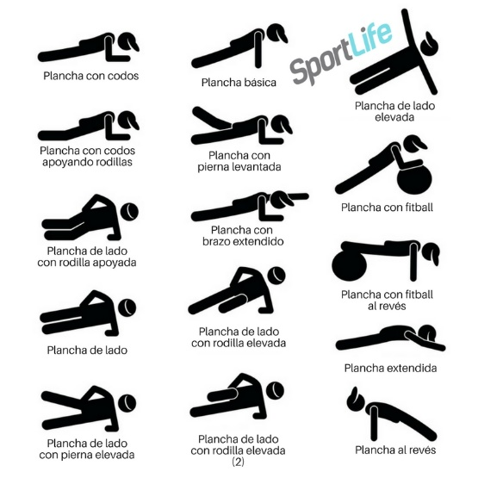
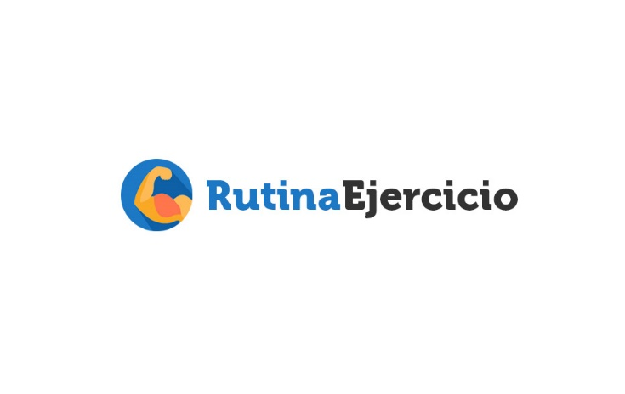
Work out
The benefits of doing aerobic activities such as running, swimming, walking and cycling are several: greater resistance to disease, reduction of stress, self-confidence, weight loss, increased self-esteem and regularization of metabolism. However, it is important to do medical exams and take some precautions before starting any physical exercise.
Recognize your limits. Start calmly and do not overdo it on the first day. It is necessary to respect the times to create resistance and accustom the body. To take better advantage of your activity, pay attention to two very important points: stretching and hydration. Before and after starting your exercises do a sequence of stretches to avoid muscle injuries. Take also the necessary care with your hydration, drinking plenty of water to replace the fluid eliminated by the sweat. (Learn about the importance of water)
If you are already in menopause, be sure to visit your doctor to tell you how much calcium you should take to prevent possible bone disease. Regular exercises with light weights are among the most important prevention measures. As well as the muscles, the bones are strengthened when they are exercised. In this stage, walking is an excellent exercise for those who want to exercise. The upper body also needs attention. Dolls and vertebrae, as well as quadriles, have bones more prone to breakage due to osteoporosis. Use aerobic exercise equipment with light weights. Remember to consult with your specialist before starting an exercise program. The important thing is to always do an activity that you like.

